Slide 1
Predicates

Slide 2
Translate each of these statements into logical expressions
using predicates, quantifiers, and logical connectives.
a) No one is perfect.
b) Not everyone is perfect.
c) All your friends are perfect.
d) At least one of your friends is perfect.
e) Everyone is your friend and is perfect.
f ) Not everybody is your friend or someone is not perfect.

Slide 3

Let P(x) : x is perfect
F(x) : x is your friend.
$∀$x $\sim$P(x)
$\sim$($∀$x $\sim$P(x))
$∀$x (F(x) $⇒P(x))$
$∃x\left(F\left(x\right)ΛP\left(x\right)\right)$
$∀$x (F(x) $Λ$ $P(x))$
$\sim ∀xF\left(x\right)V(∃x\sim P\left(x\right))$

Slide 4
Translate these specifications into English where F(p) is
“Printer p is out of service,” B(p) is “Printer p is busy,”
L(j) is “Print job j is lost,” and Q(j) is “Print job j is
queued.”
a) ∃p(F(p) ∧ B(p)) → ∃jL(j)
b) ∀pB(p) → ∃jQ(j)
c) ∃j (Q(j) ∧ L(j)) → ∃pF(p)
d) (∀pB(p) ∧ ∀jQ(j)) → ∃jL(j)

Slide 5
39. a) If there is a printer that is both out of service and
busy, then some job has been lost.
b) If every printer is busy, then there is a job in the queue.
c) If there is a job that is both queued and lost, then some printer is out of service.
d) If every printer is busy and every job is queued, then some job is lost.

Slide 6
Nested Quantifiers
∀x∃y(x + y = 0).
Note that everything within the scope of a quantifier can be thought of as a propositional function.
For example,
∀x∃y(x + y = 0)
is the same thing as ∀xQ(x), where Q(x) is ∃yP(x, y), where P(x, y) is x + y = 0.

Slide 7
Assume that the domain for the variables x and y consists of all real numbers. The statement ∀x∀y(x + y = y + x) says that x + y = y + x for all real numbers x and y. This is the commutative law for addition of real numbers. Likewise, the statement
∀x∃y(x + y = 0) says that for every real number x there is a real number y such that x + y = 0. This states that every real number has an additive inverse. Similarly, the statement
∀x∀y∀z(x + (y + z) = (x + y) + z)
is the associative law for addition of real numbers.

Slide 8
Let Q(x, y) denote “x + y = 0.” What are the truth values of the quantifications ∃y∀xQ(x, y)
and ∀x∃yQ(x, y), where the domain for all variables consists of all real numbers?
Solution: The quantification ∃y∀xQ(x, y) denotes the proposition “There is a real number y such that for every real number x, Q(x, y).”
No matter what value of y is chosen, there is only one value of x for which x + y = 0. Because there is no real number y such that x + y = 0 for all real numbers x, the statement ∃y∀xQ(x, y) is false.
The quantification ∀x∃yQ(x, y) denotes the proposition
“For every real number x there is a real number y such that Q(x, y).”
Given a real number x, there is a real number y such that x + y = 0; namely, y = −x. Hence,
the statement ∀x∃yQ(x, y) is true.

Slide 10
Q. Express the statement “If a person is female and is a parent, then this person is someone’s mother” as a logical expression involving predicates, quantifiers with a domain consisting of all people, and logical connectives.
Solution: The statement “If a person is female and is a parent, then this person is someone’s mother” can be expressed as “For every person x, if person x is female and person x is a parent, then there exists a person y such that person x is the mother of person y.”
We introduce the propositional functions F(x) to represent “x is female,” P(x) to represent “x is a parent,” and M(x, y) to represent “x is the mother of y.” The original statement can be represented as
∀x((F (x) ∧ P(x)) → ∃yM(x, y)).
we can move ∃y to the left so that it appears just after ∀x, because y does not appear in F(x) ∧ P(x). We obtain the logically equivalent expression
∀x∃y((F (x) ∧ P(x)) → M(x, y)).

Slide 13
p → q (p implies q): the proposition “if p, then q,” which is
false if and only if p is true and q is false
converse of p→q: the conditional statement q → p
contrapositive of p→q: the conditional statement ￢q →￢p
inverse of p→q: the conditional statement ￢p →￢q

Slide 16
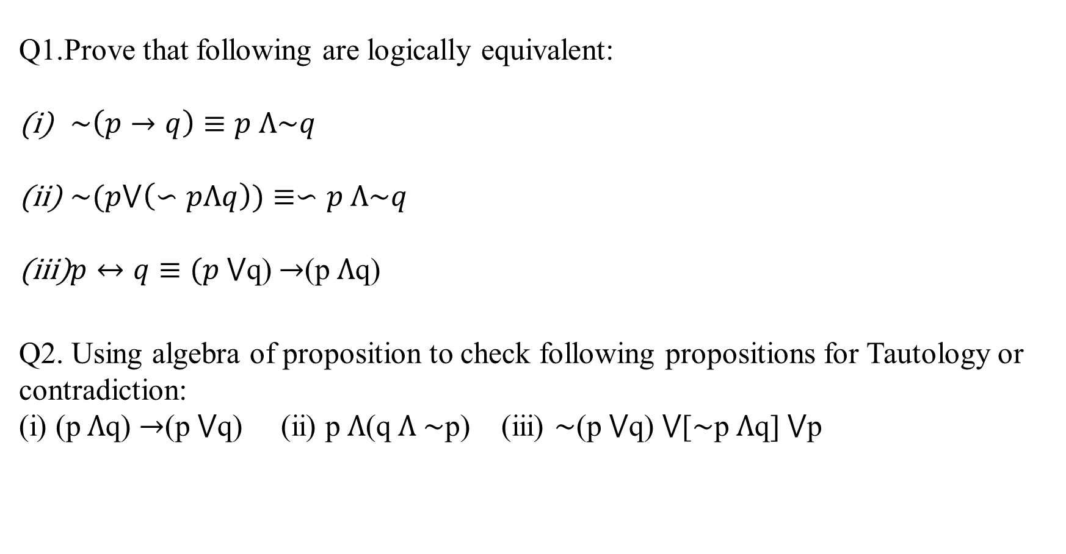
Q1.Prove that following are logically equivalent:
$\sim \left(p→q\right)≡p Λ\sim q$
$\sim (p⋁\left(∽pΛq\right))≡∽p Λ\sim q$
$p↔q≡(p$ $⋁$q) $→$(p $Λ$q)
Q2. Using algebra of proposition to check following propositions for Tautology or contradiction:
(i) (p $Λ$q) $→$(p $⋁$q) (ii) p $Λ$(q $Λ$ $\sim$p) (iii) $\sim$(p $⋁$q) $⋁$[$\sim$p $Λ$q] $⋁$p

Slide 17
RULE OF INFERENCE

Slide 18
Proofs in mathematics are valid arguments that establish the truth of mathematical statements.
By an argument, we mean a sequence of statements that end with a conclusion. By valid, we mean that the conclusion, or final statement of the argument, must follow from the truth of the preceding statements, or premises, of the argument.
That is, an argument is valid if and only if it is impossible for all the premises to be true and the conclusion to be false.
To deduce new statements from statements we already have, rules of inference which are templates for constructing valid arguments.
Rules of inference are our basic tools for establishing the truth of statements.

Slide 19
These rules of inference for statements involving existential and universal
quantifiers play an important role in proofs in computer science and mathematics, although they are often used without being explicitly mentioned.
Consider the following argument involving propositions (which, by definition, is a sequence of propositions):
“If you have a current password, then you can log onto the network.”
“You have a current password.”
Therefore,
“You can log onto the network.”
We would like to determine whether this is a valid argument.

Slide 20
That is, we would like to determine whether the conclusion “You can log onto the network” must be true when the premises “If you have a current password, then you can log onto the network” and “You have a current password” are both true.
Before we discuss the validity of this particular argument, we will look at its form. Use p to represent “You have a current password” and q to represent “You can log onto the network.”
Then, the argument has the form
p → q
P
--------
∴ q
where ∴ is the symbol that denotes “therefore.”

Slide 21
An argument in propositional logic is a sequence of propositions. The initial proposition in the argument are called premises and the final proposition is called the conclusion. An argument is valid if the truth of all its premises implies that the conclusion is true.
An argument form in propositional logic is a sequence of compound propositions involving propositional variables. An argument form is valid no matter which particular propositions are substituted for the propositional variables in its premises, the conclusion is true if the premises are all true.

Slide 22
we can first establish the validity of some relatively simple argument forms, called rules of inference. These rules of inference can be used as building blocks to construct more complicated valid argument forms.
We will now introduce the most important rules of inference in propositional logic.

Slide 23
The tautology (p ∧ (p → q)) → q is the basis of the rule of inference called modus ponens, or the law of detachment. (Modus ponens is Latin for mode that affirms.) This tautology leads to the following valid argument form, which we have already seen in our initial discussion about arguments (where, as before, the symbol ∴ denotes “therefore”):
p
p → q
-----------
∴ q
Suppose that the conditional statement “If it snows today, then we will go skiing” and its
hypothesis, “It is snowing today,” are true. Then, by modus ponens, it follows that the conclusion of the conditional statement, “We will go skiing,” is true.

Slide 25
Q1.State which rule of inference is the basis of the following argument: “It is below freezing now. Therefore, it is either below freezing or raining now.”
Solution: Let p be the proposition “It is below freezing now” and q the proposition “It is raining now.” Then this argument is of the form
p
∴ p ∨ q
This is an argument that uses the addition rule.

Slide 26
Q2. State which rule of inference is used in the argument:
If it rains today, then we will not have a barbecue today. If we do not have a barbecue today, then we will have a barbecue tomorrow. Therefore, if it rains today, then we will have a barbecue tomorrow.
Solution: Let p be the proposition “It is raining today,” let q be the proposition “We will not have a barbecue today,” and let r be the proposition “We will have a barbecue tomorrow.” Then
this argument is of the form
p → q
q → r
∴ p → r
Hence, this argument is a hypothetical syllogism.

Slide 27
Using Rules of Inference to Build Arguments

Slide 28
Q. Show that the premises “It is not sunny this afternoon and it is colder than yesterday,” “We will go swimming only if it is sunny,” “If we do not go swimming, then we will take a canoe trip,” and “If we take a canoe trip, then we will be home by sunset” lead to the conclusion “We will be home by sunset.”
Solution: Let p be the proposition “It is sunny this afternoon,”
q the proposition “It is colder than yesterday,”
r the proposition “We will go swimming,”
s the proposition “We will take a canoe trip,” and
t the proposition “We will be home by sunset.”
Then the premises become
￢p ∧ q, r → p,￢r → s, and s → t .

Slide 29
The conclusion is simply t . We need to give a valid argument with premises ￢p ∧ q, r → p, ￢r → s, and s → t and conclusion t .
We construct an argument to show that our premises lead to the desired conclusion as
follows.
Step Reason
1. ￢p ∧ q Premise
2. ￢p Simplification using (1)
3. r → p Premise
4. ￢r Modus tollens using (2) and (3)
5. ￢r → s Premise
6. s Modus ponens using (4) and (5)
7. s → t Premise
8. t Modus ponens using (6) and (7)

Slide 30
Q. Show that the premises “If you send me an e-mail message, then I will finish writing the program,” “If you do not send me an e-mail message, then I will go to sleep early,” and “If I go to sleep early, then I will wake up feeling refreshed” lead to the conclusion “If I do not finish writing the program, then I will wake up feeling refreshed.”
Solution: Let p be the proposition “You send me an e-mail message,”
q the proposition “I will finish writing the program,”
r the proposition “I will go to sleep early,” and
s the proposition “I willwake up feeling refreshed.”
Then the premises are p → q, ￢p → r, and r → s.
The desired conclusion is ￢q → s.
We need to give a valid argument with premises p → q, ￢p → r, and
r → s and conclusion ￢q → s.

Slide 31
This argument form shows that the premises lead to the desired conclusion.
Step Reason
1. p → q Premise
2. ￢q →￢p Contrapositive of (1)
3. ￢p → r Premise
4. ￢q → r Hypothetical syllogism using (2) and (3)
5. r → s Premise
6. ￢q → s Hypothetical syllogism using (4) and (5)

Slide 33
Proof is a valid argument that establishes the truth of a mathematical statement. A proof can use the hypotheses of the theorem, if any, axioms assumed to be true, and previously proven theorems. Using these ingredients and rules of inference, the final step of the proof establishes the truth of the statement being proved.
In our discussion, we move from formal proofs of theorems to more informal proofs. The arguments we introduced to show that statements involving propositions and quantified statements are true were formal proofs, where all steps were supplied, and the rules for each step in the argument were given. However, formal proofs of useful theorems can be extremely long and hard to follow.

Slide 34
In practice, the proofs of theorems designed for human consumption are almost always informal proofs, where more than one rule of inference may be used in each step, where steps may be skipped, where the axioms are assumed, and the rules of inference used are not explicitly stated. Informal proofs can often explain to humans why theorems are true, while computers are perfectly happy producing formal proofs using automated reasoning systems. The methods of proof discussed are important not only because they are used to prove mathematical theorems, but also for their many applications to computer science. These applications include verifying that computer programs are correct, establishing that operating systems are secure, making inferences in artificial intelligence, showing that system specifications are consistent, and so on. Consequently, understanding the techniques used in proofs is essential both in mathematics and in computer science

Slide 36
Theorem: A theorem is a statement that can be shown to be true. In mathematical writing, the term theorem is usually reserved for a statement that is considered at least somewhat important. Less important theorems sometimes are called propositions. (Theorems can also be referred to as facts or results.) A theorem may be the universal quantification of a conditional statement with one or more premises and a conclusion.
Proof: Proof is a valid argument that establishes the truth of a theorem. We demonstrate that a theorem is true with proof.
Axioms: The statements used in a proof can include axioms (or postulates), which are statements we assume to be true. Axioms may be stated using primitive terms that do not require definition, but all other terms used in theorems and their proofs must be defined.

Slide 37
Lemma: A less important theorem that is helpful in the proof of other results is called a lemma (plural lemmas or lemmata). Complicated proofs are usually easier to understand when they are proved using a series of lemmas, where each lemma is proved individually.
For example: Euclid's division lemma states that for any two positive integers a and b, there exist two unique whole numbers say q and r, such that
a = bq + r , where 0 ≤ r < b
Here, a = Dividend , b = Divisor , q = Quotient , r = Remainder
It can be written as,
Dividend = (Divisor × Quotient) + Remainder
A corollary is a theorem that can be established directly from a theorem that has been proved.

Slide 38
A conjecture is a statement that is being proposed to be a true statement, usually on the basis of some partial evidence, a heuristic argument, or the intuition of an expert. When a proof of a conjecture is found, the conjecture becomes a theorem. Many times conjectures are shown to be false, so they are not theorems. For example, make a conjecture about the next number in the pattern 2,6,11,15... The terms increase by 4, then 5, and then 6. Conjecture: the next term will increase by 7, so it will be 17+7=24.

Slide 39
Proving mathematical theorems can be difficult. To construct proofs we need all available ammunition, including a powerful battery of different proof methods. These methods provide the overall approach and strategy of proofs. Understanding these methods is a key component of learning how to read and construct mathematical proofs. One we have chosen a proof method, we use axioms, definitions of terms, previously proved results, and rules of inference to complete the proof. We will also assume the usual axioms whenever we prove a result about geometry. When you construct your own proofs, be careful not to use anything but axioms, definitions, and previously proved results as facts. To prove a theorem of the form ∀x(P (x) → Q(x)), our goal is to show that P (c) → Q(c) is true, where c is an arbitrary element of the domain, and then apply universal generalization.

Slide 40
Types of Proofs:
Direct proof
Indirect proofs:
(a) Proof by Contraposition
(b) Proofs by Contradiction
(c ) Proofs of equivalence

Slide 41
Direct proof: A direct proof of a conditional statement p → q is constructed when the first step is the assumption that p is true; subsequent steps are constructed using rules of inference, with the final step showing that q must also be true. A direct proof shows that a conditional statement p → q is true by showing that if p is true, then q must also be true, so that the combination p true and q false never occurs. In a direct proof, we assume that p is true and use axioms, definitions, and previously proven theorems, together with rules of inference, to show that q must also be true. We find that direct proofs of many results are quite straightforward, with a fairly obvious sequence of steps leading from the hypothesis to the conclusion.

Slide 42
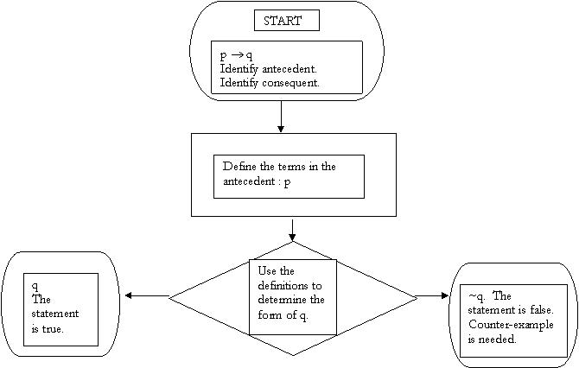
Direct Proof

Slide 43
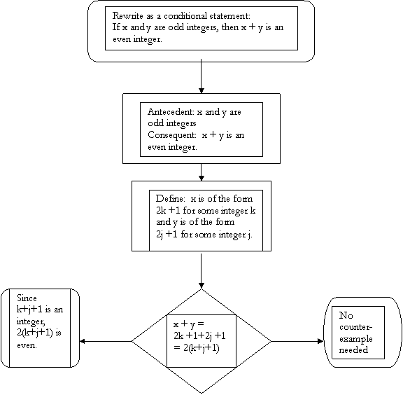
Theorem: The sum of two odd numbers is an even number.

Slide 44
Theorem: The sum of two odd numbers is an even number. Proof: First we rewrite the statement as a conditional: If x and y are two odd integers, then x + y is an even integer. Let x = 2k + 1 for some integer k. Let y = 2j + 1 for some integer j. We need the sum x + y to be an integral multiple of two. Observing that x + y = 2k + 1 + 2j +1, rearranging the terms, and simplifying gives x + y = 2k + 2j +2 = 2(k + j +1). Since k + j + 1 is an integer, it follows that x + y is an even integer.

Slide 45
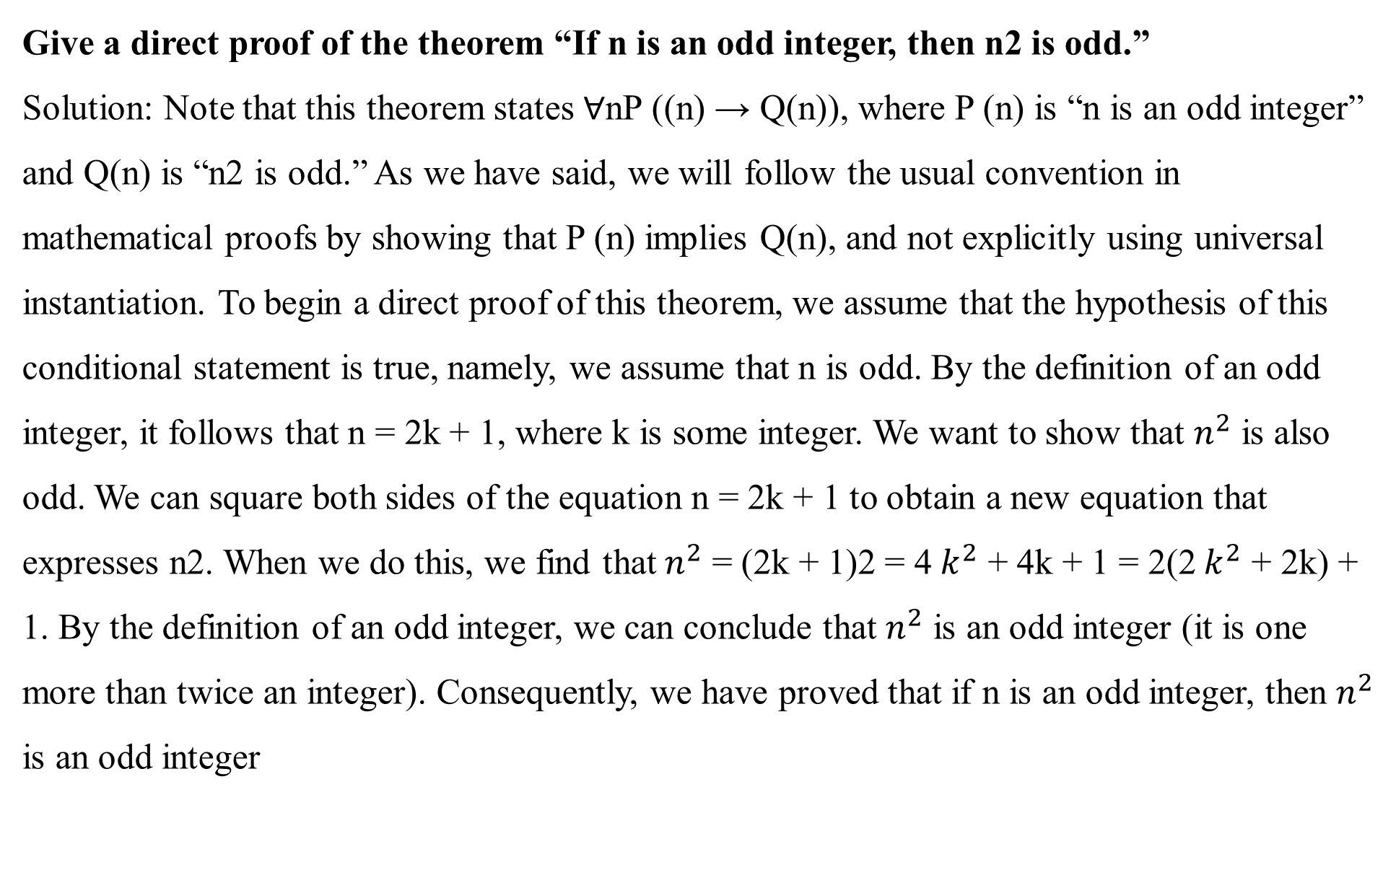
Give a direct proof of the theorem “If n is an odd integer, then n2 is odd.”
Solution: Note that this theorem states ∀nP ((n) → Q(n)), where P (n) is “n is an odd integer” and Q(n) is “n2 is odd.” As we have said, we will follow the usual convention in mathematical proofs by showing that P (n) implies Q(n), and not explicitly using universal instantiation. To begin a direct proof of this theorem, we assume that the hypothesis of this conditional statement is true, namely, we assume that n is odd. By the definition of an odd integer, it follows that n = 2k + 1, where k is some integer. We want to show that $n^{2}$ is also odd. We can square both sides of the equation n = 2k + 1 to obtain a new equation that expresses n2. When we do this, we find that $n^{2}$ = (2k + 1)2 = 4 $k^{2}$ + 4k + 1 = 2(2 $k^{2}$ + 2k) + 1. By the definition of an odd integer, we can conclude that $n^{2}$ is an odd integer (it is one more than twice an integer). Consequently, we have proved that if n is an odd integer, then $n^{2}$ is an odd integer

Slide 46
(ii) Indirect Proof
(a) Proof by Contraposition
(b) Proofs by Contradiction
(c ) Proofs of Equivalence
Notes:
Flow chart of indirect proof is on next slide

Slide 47
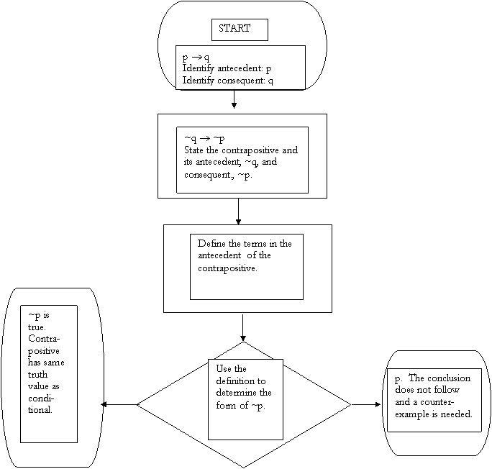

Slide 48
Proof by Contraposition: An extremely useful type of indirect proof is known as proof by contraposition. Proofs by contraposition make use of the fact that the conditional statement p → q is equivalent to its contrapositive, ¬q → ¬p. This means that the conditional statement p → q can be proved by showing that its contrapositive, ¬q → ¬p, is true.
In a proof by contraposition of p → q, we take ¬q as a premise, and using axioms, definitions, and previously proven theorems, together with rules of inference, we show that ¬p must follow.

Slide 49
Prove that if n is an integer and 3n + 2 is odd, then n is odd.
Solution: We first attempt direct proof. To construct a direct proof, we first assume that 3n + 2 is an odd integer. This means that 3n + 2 = 2k + 1 for some integer k. We see that 3n + 1 = 2k, but there does not seem to be any direct way to conclude that n is odd. Because our attempt at a direct proof failed, we next try a proof by contraposition.
The first step in a proof by contraposition is to assume that the conclusion of the conditional statement “If 3n + 2 is odd, then n is odd” is false; namely, assume that n is even. Then, by the definition of an even integer, n = 2k for some integer k. Substituting 2k for n, we find that 3n + 2 = 3(2k) + 2 = 6k + 2 = 2(3k + 1). This tells us that 3n + 2 is even (because it is a multiple of 2), and therefore not odd. This is the negation of the premise of the theorem.

Slide 50
Because the negation of the conclusion of the conditional statement implies that the hypothesis is false, the original conditional statement is true. Our proof by contraposition succeeded; we have proved the theorem “If 3n + 2 is odd, then n is odd.”

Slide 51
VACUOUS AND TRIVIAL PROOFS :We can quickly prove that a conditional statement p → q is true when we know that p is false, because p → q must be true when p is false. Consequently, if we can show that p is false, then we have a proof, called a vacuous proof, of the conditional statement p → q. Vacuous proofs are often used to establish special cases of theorems that state that a conditional statement is true for all positive integers [i.e., a theorem of the kind ∀nP (n), where P (n) is a propositional function].
We can also quickly prove a conditional statement p → q if we know that the conclusion q is true. By showing that q is true, it follows that p → q must also be true. A proof of p → q that uses the fact that q is true is called a trivial proof. Trivial proofs are often important when special cases of theorems are proved

Slide 52
Proofs by Contradiction Suppose we want to prove that a statement p is true. Furthermore, suppose that we can find a contradiction q such that ¬p → q is true. Because q is false, but ¬p → q is true, we can conclude that ¬p is false, which means that p is true. How can we find a contradiction q that might help us prove that p is true in this way? Because the statement r ∧ ¬r is a contradiction whenever r is a proposition, we can prove that p is true if we can show that ¬p → (r ∧ ¬r) is true for some proposition r. Proofs of this type are called proofs by contradiction. Because a proof by contradiction does not prove a result directly, it is another type of indirect proof.

Slide 53
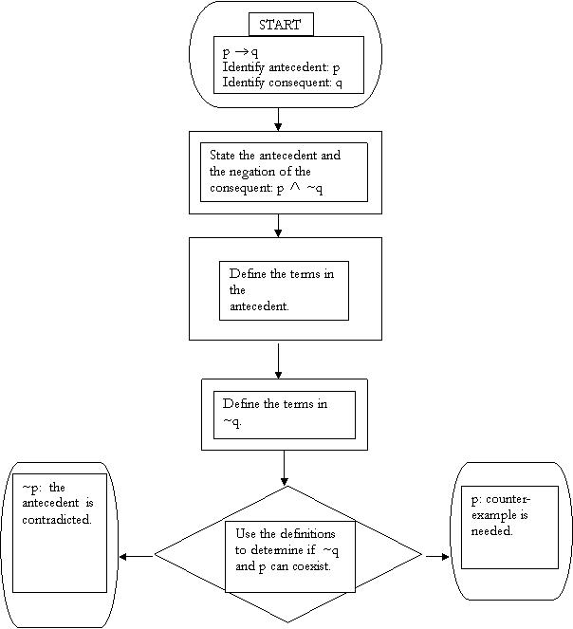
Proof by Contradiction

Slide 54
Proof by contradiction can be used to prove conditional statements. In such proofs, we first assume the negation of the conclusion. We then use the premises of the theorem and the negation of the conclusion to arrive at a contradiction. (The reason that such proofs are valid rests on the logical equivalence of p → q and (p ∧ ¬q) → F. To see that these statements are equivalent, simply note that each is false in exactly one case, namely when p is true and q is false.) Note that we can rewrite a proof by contraposition of a conditional statement as proof by contradiction. In proof of p → q by contraposition, we assume that ¬q is true. We then show that ¬p must also be true. To rewrite a proof by contraposition of p → q as proof by contradiction, we suppose that both p and ¬q are true. Then, we use the steps from the proof of ¬q → ¬p to show that ¬p is true. This leads to the contradiction p ∧ ¬p, completing the proof. Example 11 illustrates how proof by contraposition of a conditional statement can be rewritten as proof by contradiction.
Theorem: Prove that if x is a rational number and y is an irrational number, then x + y is an irrational number.

Slide 55
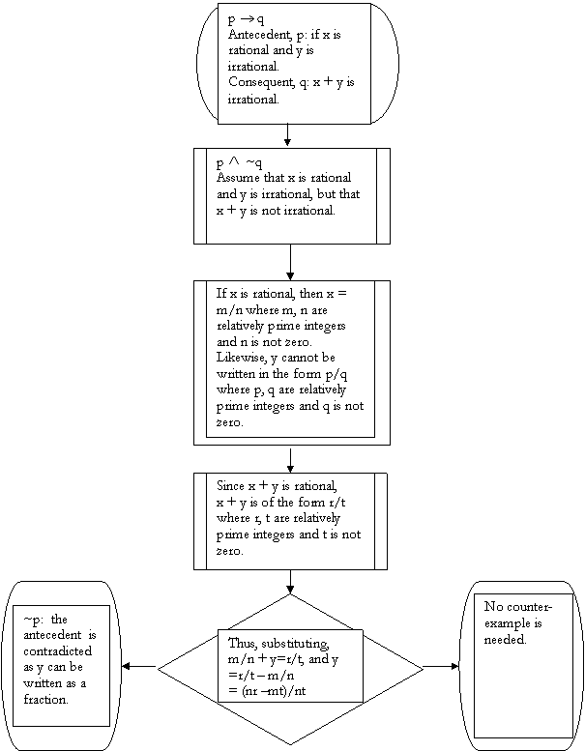

Slide 56
PROOFS OF EQUIVALENCE: To prove a theorem that is a biconditional statement, that is, a statement of the form p ↔ q, we show that p → q and q → p are both true. The validity of this approach is based on the tautology (p ↔ q) ↔ (p → q) ∧ (q → p)
Prove the theorem “If n is an integer, then n is odd if and only if $n^{2}$ is odd.

